Slide 1
The Battle of Neighborhoods
Capstone Project

Slide 2
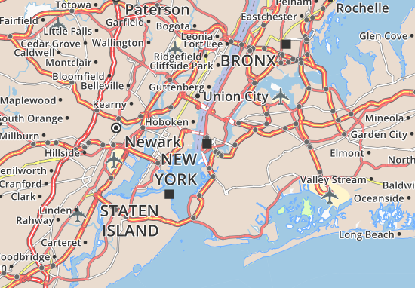
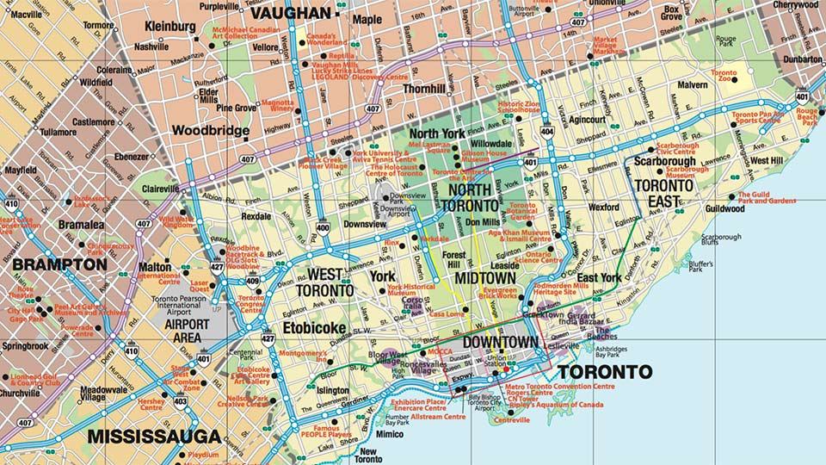
Tourism agency
Custom-made trips for Asians tourists
Decide between Toronto or New York
Explore areas with Asians restaurants
The locations have to be close

Slide 3
Data
Data is collected from different sources
New York University Spatial Data Repository
Wikipedia
Foursquare APIs

Slide 4
Conclusion
Data showed that New York has more Asians restaurants than Toronto

